Slide 1

RADV Risk Adjustment Data Validation Tool
FHIRed UP
Augusto Burgos aburgos3@gatech.edu Spiro Ganas spiroganas@gmail.com Anja Guillory anjag1993@gmail.com Jamie Richgels jrichgels3@gatech.edu Daniel Stoneburner dstoneburner3@gatech.edu Tala Suidan tmsuidan@gatech.edu
Notes:
This presentation discusses the architecture and design of RADV, the risk adjustment data validation tool created by Team FHIRed Up.

Slide 2
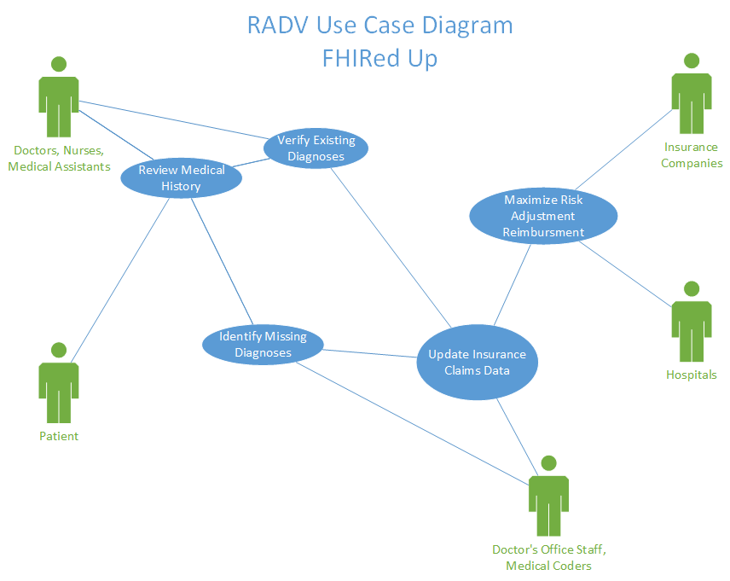
Notes:
RADV is designed to help Doctor’s, Hospitals and Insurance Companies maximize their risk adjusted reimbursements. Risk adjustment uses a patients medical history to determine their level of health. Providers who are caring for “sicker than average populations” receive greater payments. This use case diagram identifies users of the RADV system. Doctors and patients use the system to review a patients medical history. The doctor will then verify any existing diagnoses. The system then provides medical coders with data required to identify missing diagnoses and update the insurance claims data. Hospitals and insurance companies then use this corrected data to maximize their reimbursements.

Slide 3


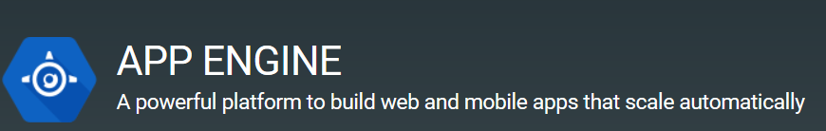
Implementation Tools & Languages
Data Tier
GaTech FHIR Server
Application Tier
Python Code
Presentation Tier
Google App Engine
HTML5
CSS
JavaScript
Notes:
The RADV tool follows the standard three-tier architecture. The data tier is Georgia Tech’s FHIR server. The application tier consists of business logic coded in the Python language. The presentation tier is and HTML5 website hosted on the Google App Engine platform. CSS was used to format the page, and JavaScript code was written to interact with the Application tier.

Slide 4
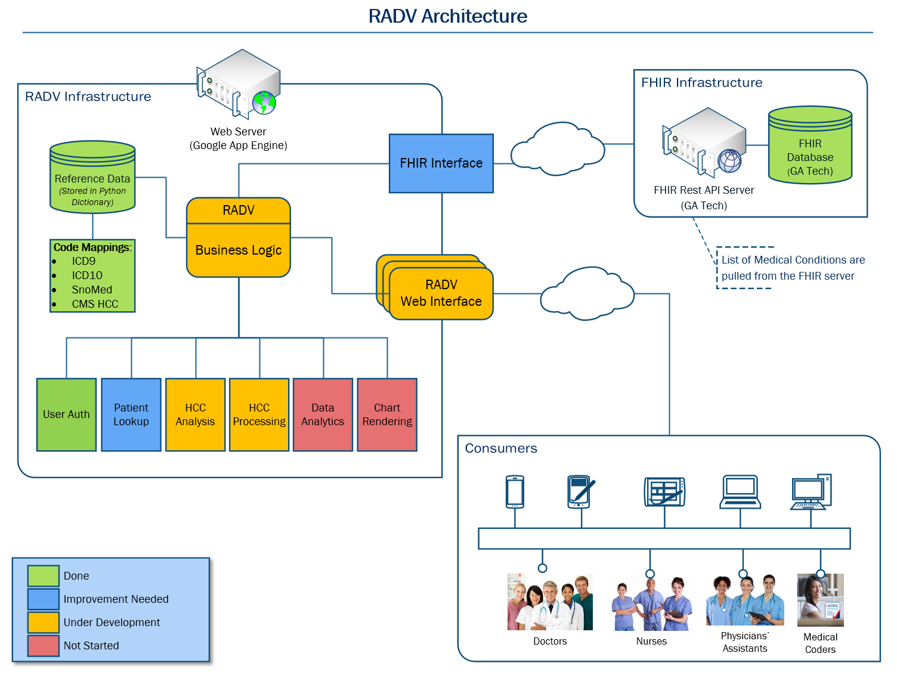
Notes:
This slide provides more details about the architecture of the RADV system. Data is stored and requested from Georgia Techs FHIR Server. A web server merges the FHIR data with reference tables and business logic. This produces information and data visualizations which are viewed by the end user through a website.

Slide 5
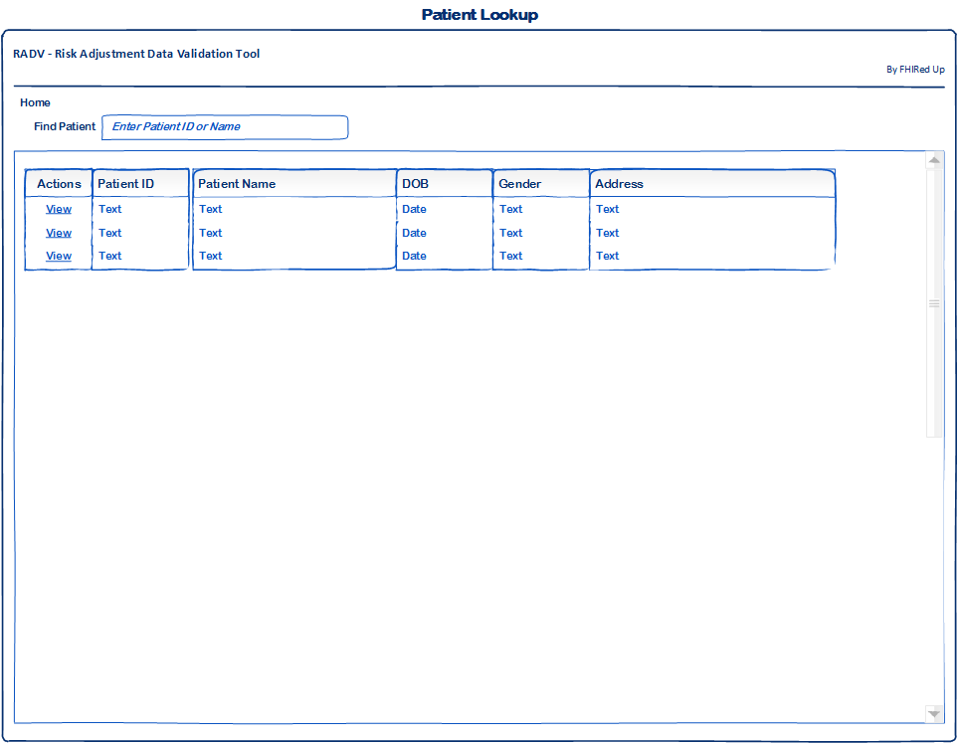
Wireframes – Patient Lookup

Slide 6
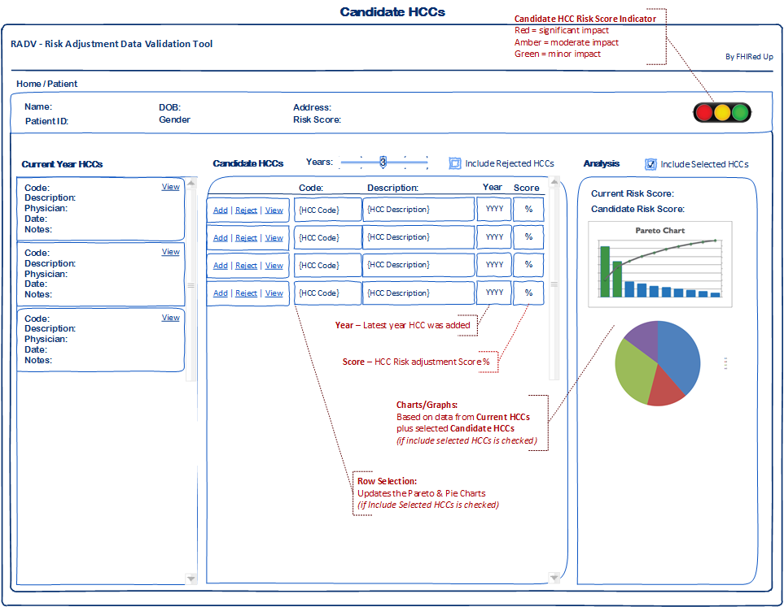
Wireframes – Candidate HCCs

Slide 7
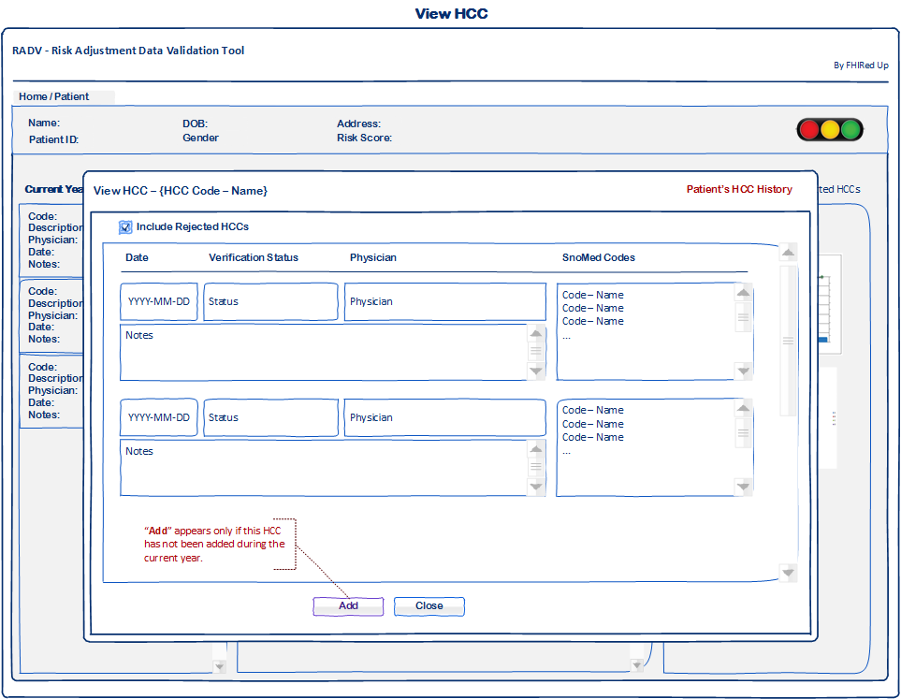
Wireframes – Viewing HCCs

Slide 8
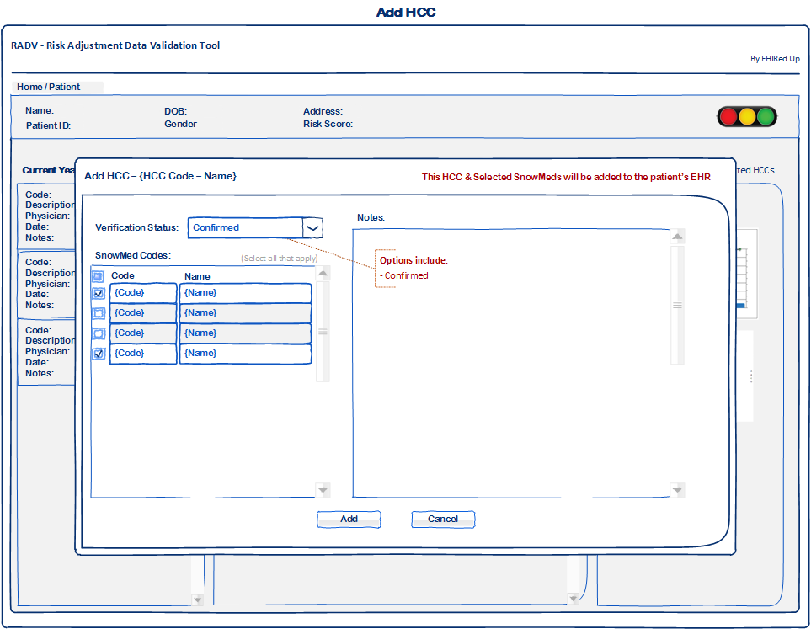
Wireframes – Adding an HCC

Slide 9
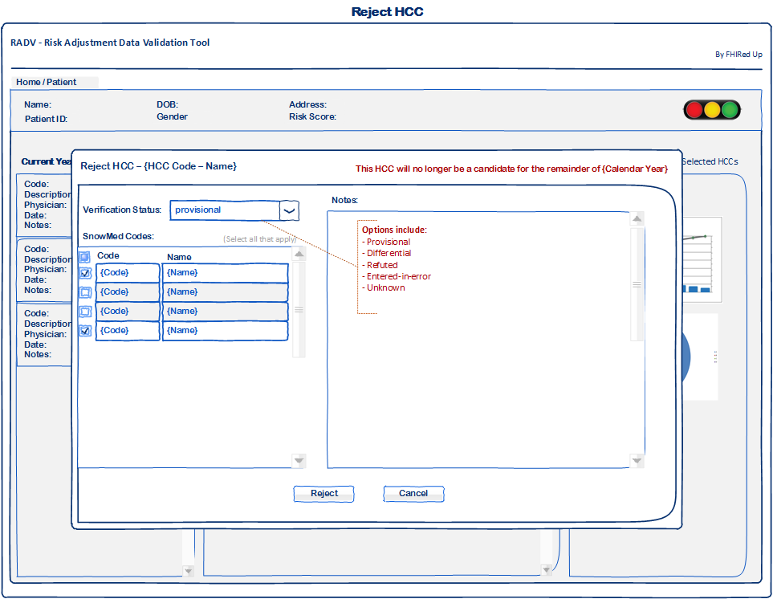
Wireframes – Rejecting an HCC

Slide 10
Data Analysis – Charts & Graphs

Slide 11
Updated Gantt Chart
* All team members involved † - Developers and testers involved ‡ - Business Analysts involved
Milestones and tasks in purple and dark blue are complete. Remainder are in progress or in the future
Notes:
Items to discuss:
Scope is set until we ensure we make the most of its current reach
First 2-week sprint is complete thanks to Augusto, Spiro, and Anja. The second sprint focuses on in progress items and improvements. All team members are assisting in developing data visualizations for the next 2 week sprint
Analysis for additional features within the scope is being done on a continual basis but only approved for each spring in the middle of the preceding sprint. – mostly by Jamie and Tala
Code testing is occurring on a continual basis by Dan and other team members.
Documentation will start once product is close to complete at end of the 3rd spring and will complete by a week after the 4th spring

Slide 12
Concerns & Other Issues
Data Visualizations – enough to impact but not overwhelm
How to ensure doctor confirms candidate HCCs

Slide 13
References
Slide 3 Image from:
https://www.hl7.org/fhir/
https://www.python.org/
https://cloud.google.com/appengine
Slide 4 images from:
http://decompressionprosmarketing.com/blogs/decompression-pros/16891112-how-to-ask-for-referrals-from-medical-doctors
http://www.libertynursingagency.com/
http://allhealthcare.monster.com/training/articles/1822-5-steps-to-becoming-a-medical-assistant
http://greenfieldcc.3dcartstores.com/Medical-Coding-and-Billing_p_1058.html

